Slide 1


Slide 2
http://arduino.cc/en/Main/Software
DOWNLOAD Arduino IDE:

Slide 3





Slide 4
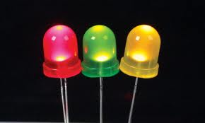
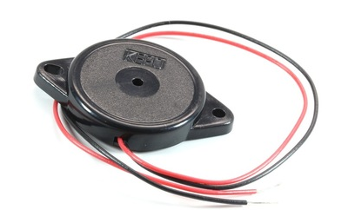
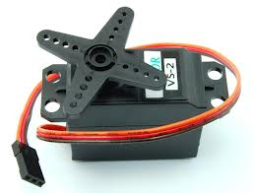
Member Workshops
Light Up My World……...........May 3
Breadboard Piano…………May 10
Servo Artist…………………….May 24

Slide 5
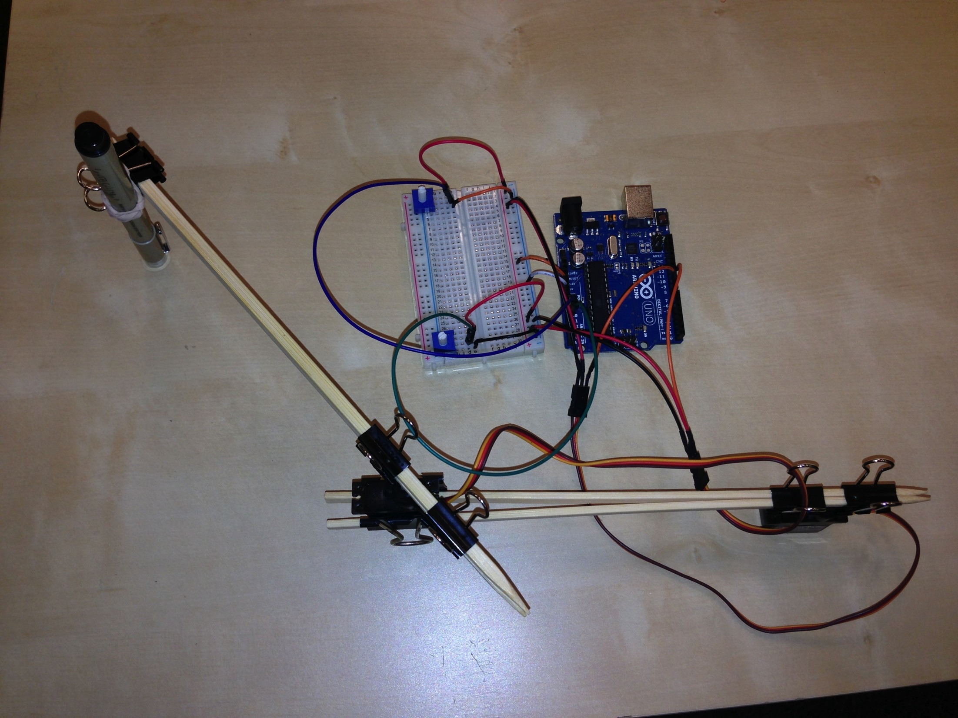
Servo Artist The Tech Museum of Innovation
Innovate with Arduino and lab instructor Tenaya Hurst

Slide 6
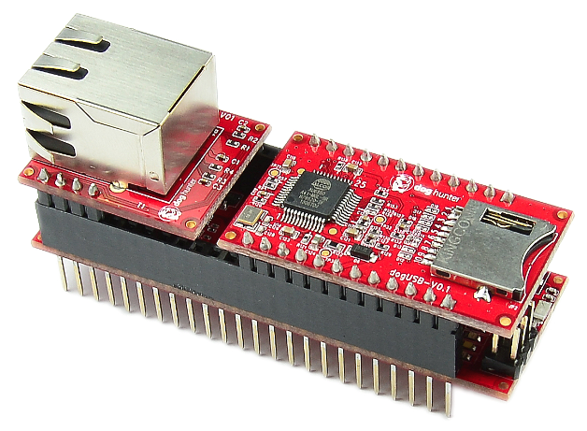
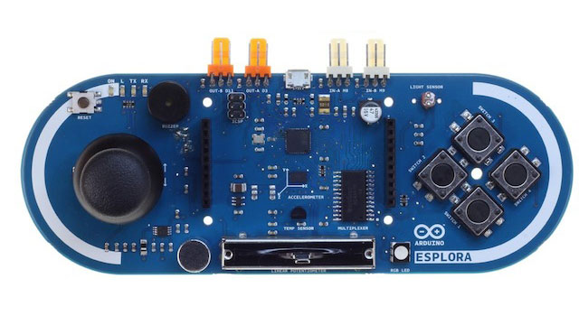
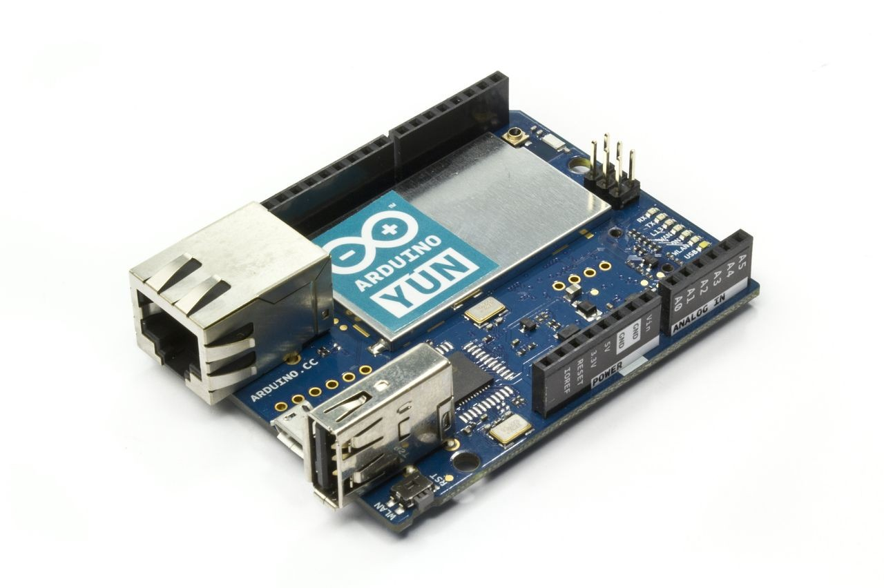
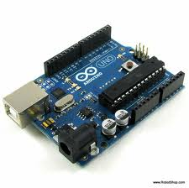
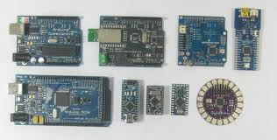
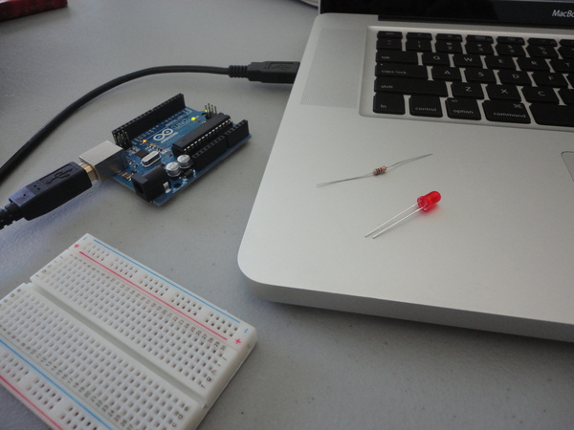

Slide 7
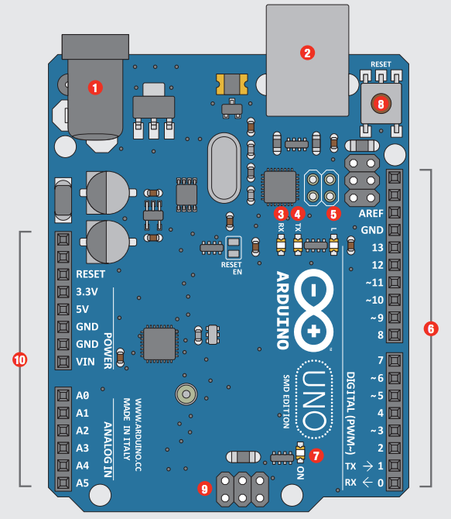
Arduino Parts
# | Function | Notes
1 | Power In | 9V battery 7-12
2 | Power In | Comp USB
3 | LED Receiving | Shows when programming
4 | LED Trans- mitting | When running program
5 | LEDTrouble shooting. | Program running proper
6 | Pins | Input, Output, Digital, Ground
7 | Power Indicator | Confirms Arduino power
8 | Reset | Manually reset
9 | ICSP Pins | Bypass boot loader
10 | Pins | Analog, Ground

Slide 8
Analog Signal vs. Digital Signal
Has a range of values
a signal that can be any value between two limits.
Denoted by Sine waves
Best for audio and video
Draw more power
Memory – wave signal
Can be affected in accuracy by external noise
On or Off
A signal that can be one of two values
Denoted by Square waves
Best for electronics
Draw less power
Memory – binary bit
More reliable with data

Slide 9
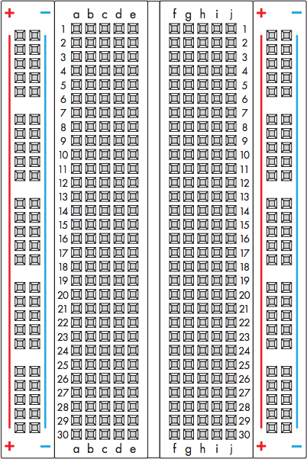
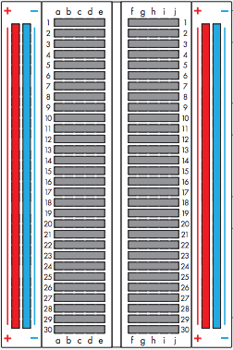
Breadboard – solderless, reusable, prototyping perforated plastic block with metal tie points to make connections Bus strips – the positive and negative vertical connections

Slide 10
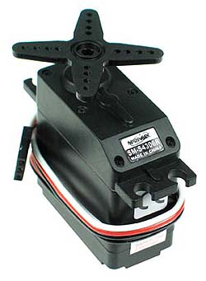

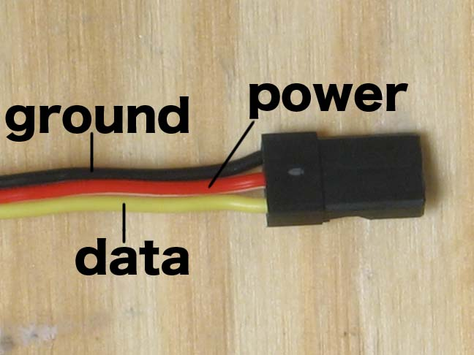
Servo Motor

Slide 11
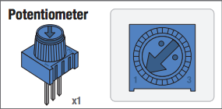
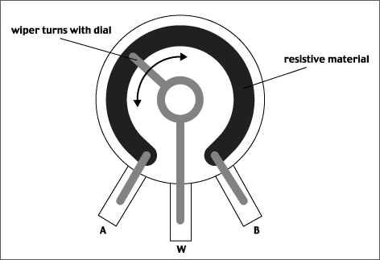

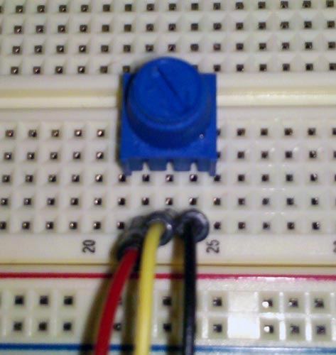
Potentiometer

Slide 12
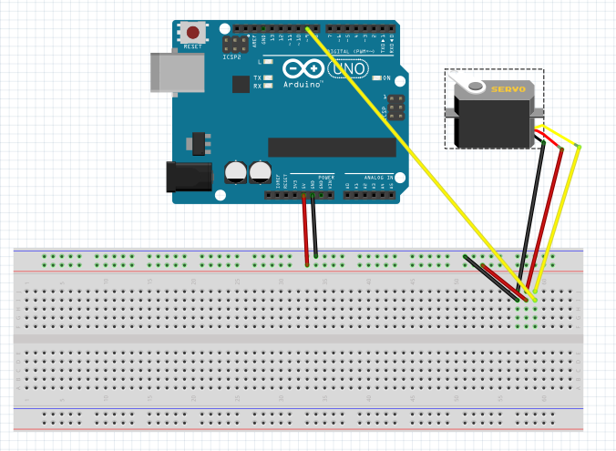
Challenge 1: Move your Servo with Programming
1 Servo
8 wires
GitHub - TMChallenge1ServoArtist
sdflksdjflsdkfjslkfjlsdkjf

Slide 13
More for #1
void loop()
{
int position;
servo1.write(90);
The servo is attempting to reset at 90 degrees right at the beginning of the code, that’s why it goes fast right away to get to that position.
Change this number to 0, 45, 90, 135, 180. See what happens!
Control your Servo!
Don’t DELETE the delays
Change the degrees your Servo turns
Adjust the pattern in the loop.
At the bottom of the code, change the 2 delays to adjust the speed of the Servo between 0 and 180 and 180 and 0 degrees.
Change the += 2 and –= 1 ratios at the end, see what happens to the speed

Slide 14
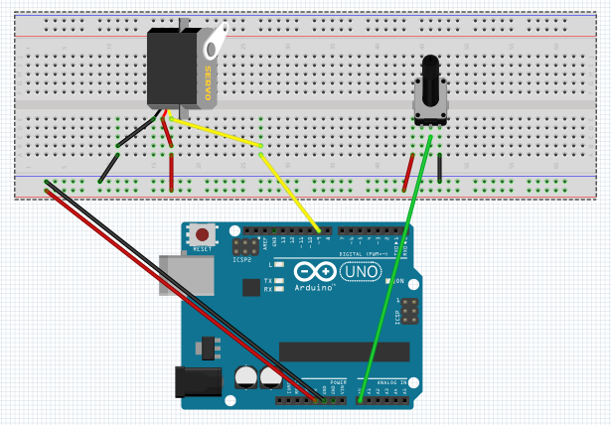
Challenge 2: Move your Servo with a Potentiometer
1 Servo
1 Potentiometer
11 wires
GitHub – TMChallenge2ServoArtist
sdflksdjflsdkfjslkfjlsdkjf

Slide 15
More for #2
change
change
Control your Servo with a Potentiometer!
change
change
change
change

Slide 16
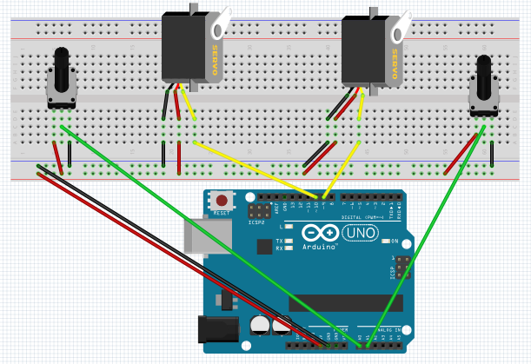
Challenge 3: Set up 2 Potentiometers for 2 Servos
2 Servos
2 Potentiometers
20 wires
GitHub – TMChallenge3_4ServoArtist
sdflksdjflsdkfjslkfjlsdkjf

Slide 17
More for #3
change
change
Control your Servos with 2 Potentiometers!
change
change
change
change

Slide 18
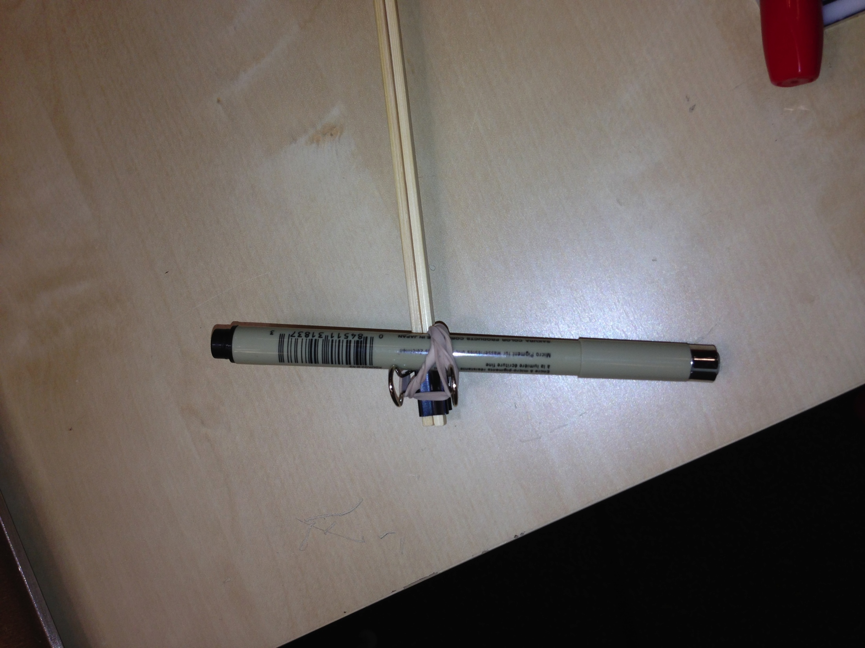
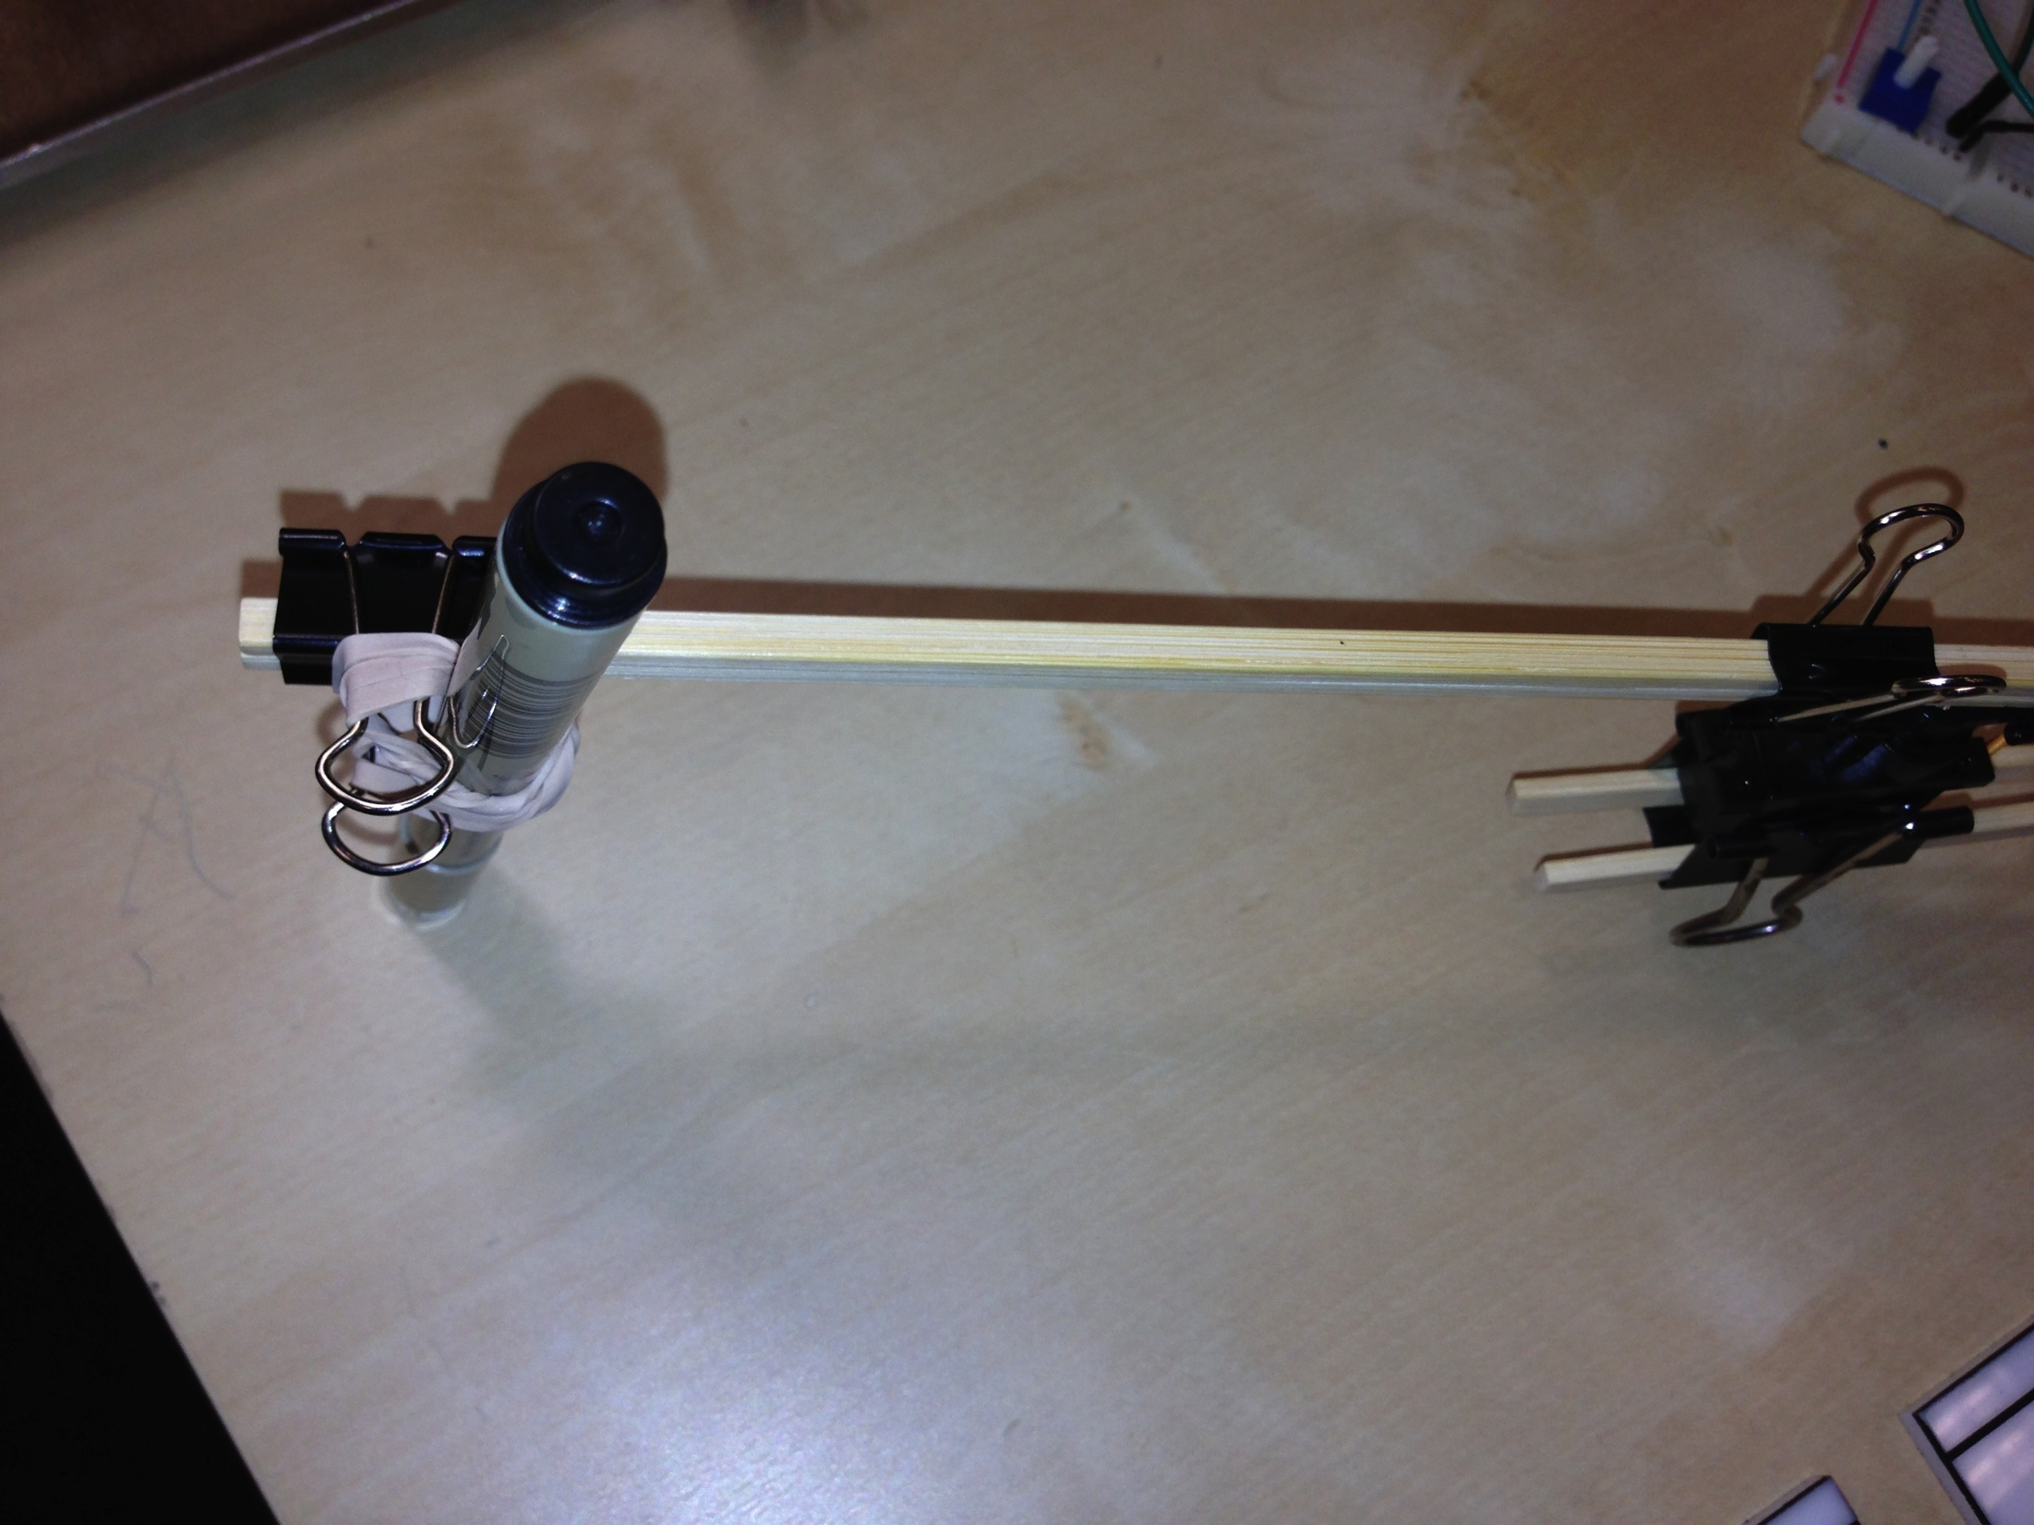
Challenge 4: Make a Servo Artist
1 pen 2 pair chopsticks
1 rubber band
1 binder clip 1.25”
5 binder clips .75”
Rubberband the pen to the end of a pair of chopsticks
Use the clips to attach to the blades of the Servos
GitHub – TMChallenge3_4ServoArtist
sdflksfsdfsdf

Slide 19
